Slide 1
Exposure vs. Efficacy/Safety in ASCENT by Singh at ASCO 2022
Trodelvy▼ (sacituzumab govitecan) in 2L and beyond mTNBC in ASCENT (Phase III)
▼Detta läkemedel är föremål för utökad övervakning.
Trodelvy® (sacituzumabgovitekan) 200 mg pulver till koncentrat till infusionsvätska, lösning. Antineoplastiska medel. Antikropp-läkemedelskonjugat. Rx., EF. Indikationer: Monoterapi vid behandling av vuxna patienter med icke-resektabel eller metastaserad, trippelnegativ bröstcancer (mTNBC) som tidigare har fått två eller flera systemiska behandlingar, varav minst en av dem mot avancerad sjukdom. Monoterapi vid behandling av vuxna patienter med icke-resektabel eller metastaserad hormonreceptor (HR)-positiv, HER2-negativ bröstcancer som har fått endokrinbaserad behandling och minst två ytterligare systemiska behandlingar för avancerad sjukdom. Kontraindikationer: Överkänslighet mot sacituzumabgovitekan eller hjälpämne. Varningar och försiktighet: Kan orsaka svår eller livshotande neutropeni. Det rekommenderas att patienternas blodvärden övervakas under behandlingen. Ska inte administreras om det absoluta antalet neutrofiler understiger 1 500/mm³ på dag 1 under någon cykel eller om antalet neutrofiler understiger 1 000/mm³ på dag 8 under någon cykel eller vid neutropen feber. Kan orsaka svår diarré. Ska inte administreras vid diarré av grad 3–4. Kan orsaka svår eller livshotande överkänslighet. Premedicinering rekommenderas och noggrann observation med avseende på infusionsrelaterade reaktioner. För att förebygga cytostatikainducerat illamående och kräkningar rekommenderas förebyggande behandling med antiemetika. Patienten måste övervakas under varje infusion och i minst 30 minuter efter varje infusion. Patienter med känd reducerad UGT1A1-aktivitet ska övervakas noga med avseende på biverkningar. Gravida kvinnor och fertila kvinnor ska informeras om den potentiella risken för foster. Innehåller natrium, ska beaktas i relation till patientens totala natriumintag. Innehavare av marknadsföringstillståndet: Gilead Sciences Ireland UC För information: Kontakta Gilead Sciences Sweden AB, + 46 (0) 8 5057 1849. För fullständig information om dosering, varningar och försiktighet, interaktioner och biverkningar samt aktuell information om förpackningar och priser se www.fass.se Baserad på produktresumé: 07/2023
Abstract: Singh et al. Journal of Clinical Oncology 2022 40:16_suppl, 1076

Slide 2
Exposure-response analyses of sacituzumab govitecan (SG) efficacy and safety in patients (pts) with metastatic triple-negative breast cancer (mTNBC)
Indrajeet Singh,¹ Abhishek G. Sathe,¹ Pratap Singh,¹ Paul M. Diderichsen,² Floris Fauchet,² John Maringwa,² Philippe Pierrillas,² See-Chun Phan,¹ Sandhya Girish,¹ Ahmed A. Othman¹
¹Gilead Sciences, Inc, Foster City, CA, USA; ²Certara USA, Inc, Princeton, NJ, USA,

Slide 3
Background
SG is a novel antibody-drug conjugate (ADC) composed of an anti–Trop-2 antibody coupled to SN-38 via a proprietary, hydrolyzable linker¹⁻⁶
SG is approved for patients with metastatic triple-negative breast cancer (mTNBC) who received ≥2 prior chemotherapies (at least 1 in the metastatic setting)^{7,8}
The phase 1/2 IMMU-132-01 and phase 3 ASCENT studies assessed the safety and efficacy of SG in patients with different types of solid tumors and mTNBC, respectively^{9,10}
This analysis characterizes the relationship between exposure of SG, Free SN-38, and Total Antibody (tAB) and the safety and efficacy of SG in patients with mTNBC, based on clinical data from the IMMU-132-01 and ASCENT studies
SG, sacituzumab govitecan; Trop-2, trophoblast cell-surface antigen-2.
1. Goldenberg DM, et al. Expert Opin Biol Ther. 2020;20:871-885. 2. Avellini C, et al. Oncotarget. 2017;8:58642-58653. 3. Nagayama A, et al. Ther Adv Med Oncol. 2020;12:1758835920915980. 4. Goldenberg DM, et al. Oncotarget. 2015;6:22496-224512. 5. Cardillo TM, et al. Bioconjugate Chem. 2015;26:919-931. 6. Govindan SV, et al. Mol Cancer Ther. 2013;12:968-978. 7. TRODELVYTM (sacituzumab govitecan-hziy). Prescribing Information. Gilead Sciences, Inc.; April 2021. 8. European Medicines Agency: Trodelvy, INN-sacituzumab govitecan, https://www.ema.europa.eu/en/documents/product-information/trodelvy-epar-product-information_en.pdf. Accessed March 2022. 9. Bardia A, et al. Ann Oncol. 2021;32:746-756. 10. Bardia A, et al. N Engl J Med. 2021;384:1529-1541.
Notes:
MAIN MESSAGE:
The objective of this analysis is to characterize the relationship between exposure of SG, Free SN-38, and Total Antibody on the safety and efficacy of SG in patients with mTNBC.
KEY POINT(S):
REFERENCE:
Singh I, et al. Presented at ASCO 2022 (abstract ID #1076). Exposure-Response Analyses of Sacituzumab Govitecan Efficacy and Safety in Patients With Metastatic Triple-Negative Breast Cancer.
ABBREVIATIONS:
mTNBC, metastatic triple negative breast cancer.

Slide 4
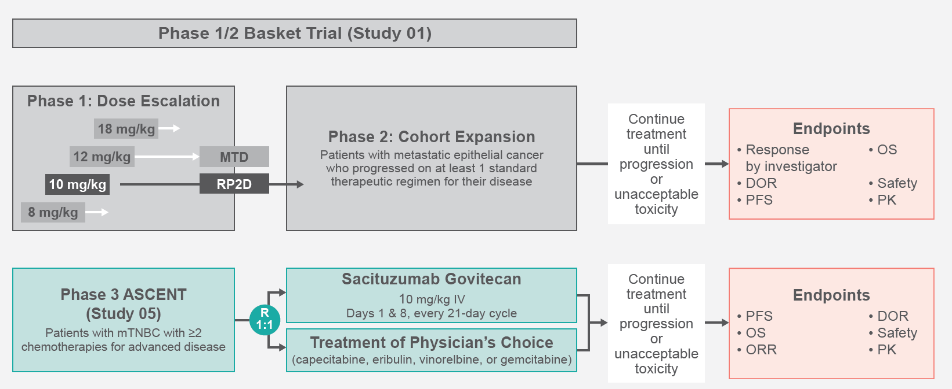
Study Design
DOR, duration of response; IV, intravenous; MTD, maximum tolerated dose; mTNBC, metastatic triple‑negative breast cancer; ORR, objective response rate; OS, overall survival; PFS, progression‑free survival; PK, pharmacokinetics; R, randomization; RP2D, recommended phase 2 dose.
1. Singh I, et al. Presented at ASCO 2022 (abstract ID #1076). Exposure-Response Analyses of Sacituzumab Govitecan Efficacy and Safety in Patients With Metastatic Triple-Negative Breast Cancer.
Notes:
MAIN MESSAGE:
This analysis included 253 patients from the phase 3 ASCENT trial and 24 patients from the phase 1/2 IMMU-132-01 basket trial.
KEY POINT(S):
REFERENCE:
Singh I, et al. Presented at ASCO 2022 (abstract ID #1076). Exposure-Response Analyses of Sacituzumab Govitecan Efficacy and Safety in Patients With Metastatic Triple-Negative Breast Cancer.
ABBREVIATIONS:

Slide 5
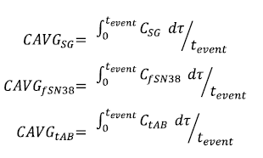
Methods
The average concentration (CAVG) of SG, Free SN-38, and tAB between the first dose and the time of event as exposure metrics for the prediction of SG efficacy and safety was defined by the following equation, where C_{SG}, C_{fSN38}, and C_{tAB} are the predicted concentrations of SG, Free SN-38, and tAB from population pharmacokinetics models¹ and t_{event} is the time to the efficacy or safety observation:
In addition to CAVG, maximum concentration (C_{max}) and area under the curve (AUC) in the first treatment cycle, and cumulative exposure until t_{event} (AUC_{tot}; for complete response [CR] and objective response rate [ORR] only) for all 3 analytes were evaluated as predictors of SG efficacy and safety
Impact of exposure on efficacy outcomes was evaluated using logistic regression (CR and ORR) or Cox Proportional-Hazards (Cox PH; overall survival [OS] and progression-free survival [PFS]) models
Impact of exposure on safety outcomes was evaluated using categorical logistic regression with non-proportional odds (adverse events [AE] of vomiting, diarrhea, hypersensitivity, nausea, and neutropenia) or Cox PH (time to first dose reduction and time to first dose delay) models
The statistically most significant analyte exposure metric was retained in the model; the effect of clinically relevant covariates including baseline body weight, age, race, lactate dehydrogenase (LDH), prior treatment, ECOG status, Trop-2 expression, UGT1A1 genotype, and granulocyte colony-stimulating factor treatment was then evaluated for statistical significance first using univariate analysis and, if significant, then included in the stepwise covariate modeling using p-value threshold of 0.01 and 0.001 for forward addition and backward elimination, respectively
The developed models were used to predict response outcomes for the 8 mg/kg vs 10 mg/kg SG dose levels
SG, sacituzumab govitecan; tAB, total antibody; TROP-2, trophoblast cell-surface antigen-2; UGT1A1, uridine 5'-diphospho-glucuronosyltransferase 1A1 gene.
1. Sathe AG, et al. ESMO Breast Cancer 2022. Poster 189P. 2. Singh I, et al. Presented at ASCO 2022 (abstract ID #1076). Exposure-Response Analyses of Sacituzumab Govitecan Efficacy and Safety in Patients With Metastatic Triple-Negative Breast Cancer.
Notes:
MAIN MESSAGE:
See slide.
KEY POINT(S):
REFERENCE:
Singh I, et al. Presented at ASCO 2022 (abstract ID #1076). Exposure-Response Analyses of Sacituzumab Govitecan Efficacy and Safety in Patients With Metastatic Triple-Negative Breast Cancer.
ABBREVIATIONS:

Slide 6
Demographics and Baseline Characteristics
 | IMMU-132-01 (n=24) | ASCENT (n=253) | Total (N=277)
Female sex, n (%) | 24 (100) | 251 (99) | 275 (99)
White race, n (%) | 16 (67) | 207 (82) | 223 (81)
Median age, y (range) | 53 (31-77) | 54 (27-82) | 54 (27-82)
ECOG PS, n (%)
0 | 12 (50) | 112 (44) | 124 (45)
1 | 12 (50) | 138 (55) | 150 (54)
2 | 0 | 3 (1) | 3 (1)
Median body weight, kg (range) | 61 (42-101) | 68 (37-132) | 67 (37-132)
Median LDH, IU/L (range)* | 241 (13-1730) | 283 (107-5930) | 277 (107-5930)
Median prior lines of chemotherapy (range) | 4 (1-7) | 4 (2-17) | 4 (1-17)
Median Trop-2 expression (H Score),† (range) | - | 220 (0-300) | 220 (0-300)
UGT1A1 genotype, n (%)
*1/*1 | 2 (8) | 110 (43) | 112 (40)
*1/*28 | 10 (42) | 95 (38) | 105 (38)
*28/*28 | 4 (17) | 34 (13) | 38 (14)
All others | 0 | 7 (3) | 7 (3)
Missing | 8 (33) | 7 (3) | 15 (5)
*1 patient in the ASCENT study had missing baseline LDH values. †Baseline Trop-2 levels in Study IMMU-132-01 were reported as a categorical variable from a different assay format. ECOG, Eastern Cooperative Oncology Group; LDH, lactate dehydrogenase; Trop-2, trophoblast cell surface antigen 2; UGT1A1, uridine 5'-diphospho-glucuronosyltransferase 1A1; PS, performance status.
1. Singh I, et al. Presented at ASCO 2022 (abstract ID #1076). Exposure-Response Analyses of Sacituzumab Govitecan Efficacy and Safety in Patients With Metastatic Triple-Negative Breast Cancer.
Notes:
MAIN MESSAGE:
Demographics and baseline characteristics were similar in the IMMU-132-01 and ASCENT patient populations.
KEY POINT(S):
REFERENCE:
Singh I, et al. Presented at ASCO 2022 (abstract ID #1076). Exposure-Response Analyses of Sacituzumab Govitecan Efficacy and Safety in Patients With Metastatic Triple-Negative Breast Cancer.
ABBREVIATIONS:

Slide 7
Exposure-Efficacy Analysis
In total, 277 patients with mTNBC from IMMU-132-01 (n=24) and ASCENT (n=253) were included in the analysis
Average SG-related serum exposures over the duration of treatment (until the event) were associated with significantly increased probability of CR and ORR, and longer OS and PFS
No additional significant covariates were identified
Higher baseline LDH levels were associated with a decreased OS while the PFS was predicted to be lower for patients previously treated with checkpoint inhibitors and platinum-based chemotherapy relative to other treatment categories
CAVG, average concentration; CR, complete response; LDH, lactate dehydrogenase mTNBC, metastatic triple negative breast cancer; ORR, objective response rate, OS, overall survival; PFS, progression free survival, SG, sacituzumab govitecan.
1. Singh I, et al. Presented at ASCO 2022 (abstract ID #1076). Exposure-Response Analyses of Sacituzumab Govitecan Efficacy and Safety in Patients With Metastatic Triple-Negative Breast Cancer.
Notes:
MAIN MESSAGE:
See slide.
KEY POINT(S):
REFERENCE:
Singh I, et al. Presented at ASCO 2022 (abstract ID #1076). Exposure-Response Analyses of Sacituzumab Govitecan Efficacy and Safety in Patients With Metastatic Triple-Negative Breast Cancer.
ABBREVIATIONS:

Slide 8
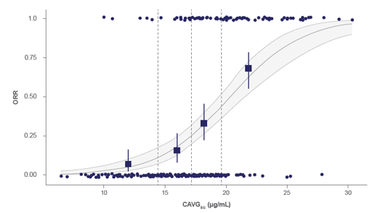
Results Observed Proportion and Predicted Probability of ORR Versus CAVG_{SG}
Dashed vertical lines in A and B indicate the boundaries of the exposure quartiles. CAVG_{SG}, average concentration of sacituzumab govitecan; ORR, objective response rate.
1. Singh I, et al. Presented at ASCO 2022 (abstract ID #1076). Exposure-Response Analyses of Sacituzumab Govitecan Efficacy and Safety in Patients With Metastatic Triple-Negative Breast Cancer.
Notes:
MAIN MESSAGE:
Higher average concentrations of SG were associated with increased probability of ORR.
KEY POINT(S):
REFERENCE:
Singh I, et al. Presented at ASCO 2022 (abstract ID #1076). Exposure-Response Analyses of Sacituzumab Govitecan Efficacy and Safety in Patients With Metastatic Triple-Negative Breast Cancer.
ABBREVIATIONS:
ORR, objective response rate; SG, sacituzumab govitecan.

Slide 9
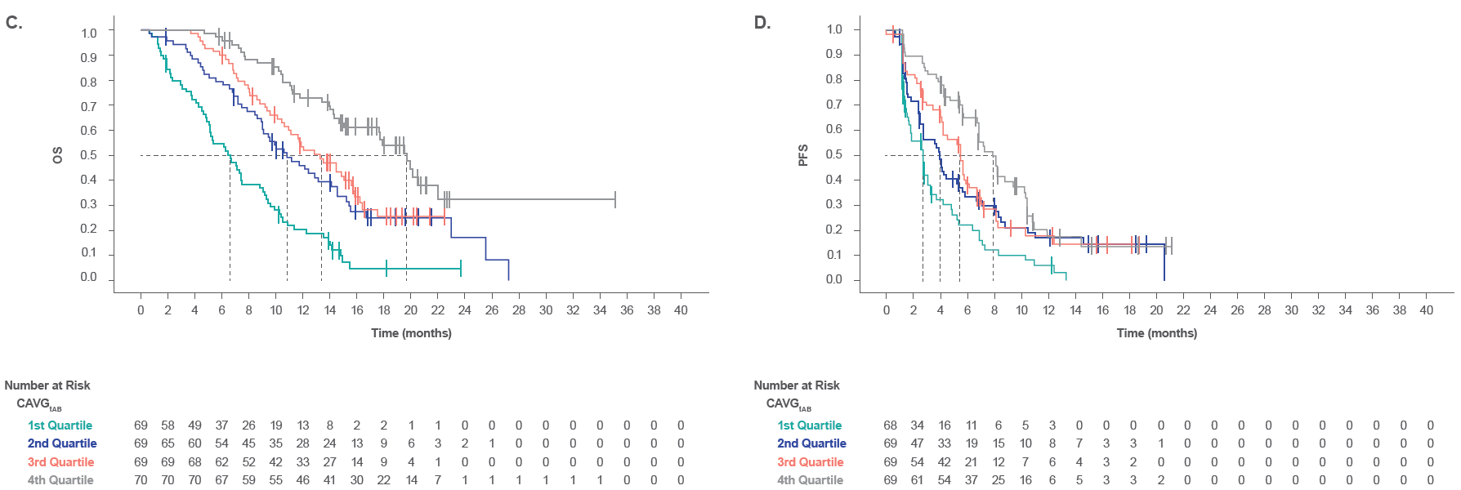
Results C. Kaplan-Meier Curve of OS Stratified by CAVG_{tAB}, D. Kaplan-Meier Curve of PFS Stratified by CAVG_{tAB}
Dashed lines in C and D indicate median OS and PFS, respectively, for each quartile. CAVG_{tAB}, average concentration of Total Antibody; OS, overall survival; PFS, progression-free survival.
1. Singh I, et al. Presented at ASCO 2022 (abstract ID #1076). Exposure-Response Analyses of Sacituzumab Govitecan Efficacy and Safety in Patients With Metastatic Triple-Negative Breast Cancer.
Notes:
MAIN MESSAGE:
Higher average concentrations of SG were associated with longer OS and PFS.
KEY POINT(S):
REFERENCE:
Singh I, et al. Presented at ASCO 2022 (abstract ID #1076). Exposure-Response Analyses of Sacituzumab Govitecan Efficacy and Safety in Patients With Metastatic Triple-Negative Breast Cancer.
ABBREVIATIONS:
OS, overall survival; PFS, progression free survival; SG, sacituzumab govitecan.

Slide 10
Results A. Model-Predicted CR and ORR Outcomes and Model-Predicted OS and PFS at 12 Months by SG Dose, B. Median Survival Times for OS and PFS Across Exposure Quartiles of CAVG_{tAB},
A.
 | Proportion at 8 mg/kg (95% CI) | Proportion at 10 mg/kg (95% CI)
CR | 0 (0-0.06) | 0.04 (0.02-0.07)
ORR | 0.13 (0-0.25) | 0.33 (0.28-0.37)
B.
Quartile | Median CAVG_{tAB}, µg/mL (range) | Median OS, mo. (95% CI)
First | 89 (51-107) | 6.6 (5.1-9.0)
Second | 125 (109-139) | 10.8 (9.0-14.5)
Third | 153 (140-173) | 13.3 (10.9-15.9)
Fourth | 204 (174-451) | 19.7 (17.6-NE)
 | Survival Probability at Mean 8 mg/kg* CAVG_{tAB} | Survival Probability at Mean 10 mg/kg CAVG_{tAB}
OS† | 0.43 (0.36-0.50) | 0.53 (0.47-0.59)
PFS‡ | 0.24 (0.12-0.37) | 0.32 (0.20-0.45)
Quartile | Median CAVG_{tAB}, µg/mL (range) | Median PFS, mo. (95% CI)§
First | 95 (51-112) | 2.8 (1.9-3.4)
Second | 130 (112-142) | 4.0 (2.8-5.7)
Third | 158 (143-174) | 5.6 (4.2-6.7)
Fourth | 205 (175-450) | 7.9 (6.9-10.4)
*Mean exposure for 8 mg/kg was based on 16 patients. †Based on median LDH of 277 IU/L. ‡Based on “Others” as prior treatment. §2 subjects with missing PFS outcome were not included in the PFS analysis.
CAVG_{tAB}, average concentration of Total Antibody; CI, confidence Intervals; CR, complete response; ORR, objective response rate; OS, overall survival; PFS, progression-free survival; SG, sacituzumab govitecan.
1. Singh I, et al. Presented at ASCO 2022 (abstract ID #1076). Exposure-Response Analyses of Sacituzumab Govitecan Efficacy and Safety in Patients With Metastatic Triple-Negative Breast Cancer.
Notes:
MAIN MESSAGE:
Higher concentrations of SG were associated with increases in the probability of response and survival.
KEY POINT(S):
The 10mg/kg starting dose of SG is associated with increased probability of ORR and CR when compared to the 8mg/kg starting dose based on model predictions.
The 10mg/kg starting dose of SG is associated with increased survival probability when compared to the 8mg/kg starting dose based on model predictions.
Higher average concentrations of SG were associated with longer OS and PFS.
REFERENCE:
Singh I, et al. Presented at ASCO 2022 (abstract ID #1076). Exposure-Response Analyses of Sacituzumab Govitecan Efficacy and Safety in Patients With Metastatic Triple-Negative Breast Cancer.
ABBREVIATIONS:
CR, complete response; ORR, objective response rate; OS, overall survival; PFS, progression free survival; SG, sacituzumab govitecan.

Slide 11
Exposure-Safety Analysis
The probability of Grade ≥1 AEs of vomiting, diarrhea, hypersensitivity reactions, nausea, or neutropenia was found to statistically significantly increase with increasing CAVG_{SG}; neutropenia was the only AE where the effect of CAVG_{SG} was statistically significant on the probability of Grade ≥3 AEs
No additional significant covariates were identified in the exposure-safety analysis
Increased CAVG_{SG} was also associated with a significantly increased probability of dose reductions and dose delays
AE, adverse event; CAVG_{SG}, average concentration of SG;
1. Singh I, et al. Presented at ASCO 2022 (abstract ID #1076). Exposure-Response Analyses of Sacituzumab Govitecan Efficacy and Safety in Patients With Metastatic Triple-Negative Breast Cancer.
Notes:
MAIN MESSAGE:
See slide.
KEY POINT(S):
REFERENCE:
Singh I, et al. Presented at ASCO 2022 (abstract ID #1076). Exposure-Response Analyses of Sacituzumab Govitecan Efficacy and Safety in Patients With Metastatic Triple-Negative Breast Cancer.
ABBREVIATIONS:
OS, overall survival; PFS, progression free survival; SG, sacituzumab govitecan.

Slide 12
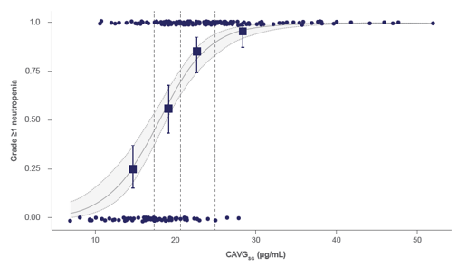
Results Observed Proportion and Predicted Probability of Grade ≥1 Neutropenia
Dashed vertical lines in A and B indicate the boundaries of the exposure quartiles. CAVG_{SG}, average concentration of sacituzumab govitecan.
1. Singh I, et al. Presented at ASCO 2022 (abstract ID #1076). Exposure-Response Analyses of Sacituzumab Govitecan Efficacy and Safety in Patients With Metastatic Triple-Negative Breast Cancer.
Notes:
MAIN MESSAGE:
Higher average concentrations of SG were associated with increased probability of Grade ≥1 Neutropenia.
KEY POINT(S):
REFERENCE:
Singh I, et al. Presented at ASCO 2022 (abstract ID #1076). Exposure-Response Analyses of Sacituzumab Govitecan Efficacy and Safety in Patients With Metastatic Triple-Negative Breast Cancer.
ABBREVIATIONS:
SG, sacituzumab govitecan.

Slide 13
Model-Predicted Odds Ratio and Proportion of Patients with AEs by SG Dose
 | Odds ratio for an increase in CAVG_{SG} by 1 µg/mL (95% CI) | Predicted proportion at 8 mg/kg (95% CI) | Predicted proportion at 10 mg/kg (95% CI)
Neutropenia
Grade ≥1 | 1.37 (1.26-1.50) | 0.38 (0.25-0.56) | 0.67 (0.62-0.72)
Grade ≥3 | 1.09 (1.05-1.14) | 0.44 (0.19-0.63) | 0.54 (0.49-0.61)
Vomiting
Grade ≥1 | 1.29 (1.18-1.39) | 0.25 (0.13-0.44) | 0.36 (0.31-0.40)
Grade ≥3 | 1.00 (0.98-1.03) | 0 (0-0.125) | 0.02 (0-0.03)
Diarrhea
Grade ≥1 | 1.45 (1.30-1.63) | 0.38 (0.25-0.50) | 0.67 (0.63-0.71)
Grade ≥3 | 1.01 (0.99-1.02) | 0.06 (0-0.25) | 0.11 (0.07-0.15)
Hypersensitivity reactions
Grade ≥1 | 1.26 (1.16-1.36) | 0.19 (0.06-0.38) | 0.35 (0.30-0.39)
Grade ≥3 | 1.00 (0.97-1.04) | 0 (0-0.06) | 0.01 (0-0.02)
Nausea
Grade ≥1 | 1.55 (1.36-1.80) | 0.63 (0.50-0.69) | 0.65 (0.61-0.68)
Grade ≥3 | 1.00 (0.99-1.02) | 0 (0-0.13) | 0.03 (0.01-0.05)
AE, adverse event; CAVG_{SG}, average concentration of SG; CI, confidence intervals; SG, sacituzumab govitecan
1. Singh I, et al. Presented at ASCO 2022 (abstract ID #1076). Exposure-Response Analyses of Sacituzumab Govitecan Efficacy and Safety in Patients With Metastatic Triple-Negative Breast Cancer.
Notes:
MAIN MESSAGE:
The probability of Grade ≥1 AEs of vomiting, diarrhea, hypersensitivity reactions, nausea, or neutropenia was found to statistically significantly increase with increasing average concentrations of SG. Neutropenia was the only AE where the effect of average concentrations of SG was statistically significant on the probability of Grade ≥3 AEs.
KEY POINT(S):
REFERENCE:
Singh I, et al. Presented at ASCO 2022 (abstract ID #1076). Exposure-Response Analyses of Sacituzumab Govitecan Efficacy and Safety in Patients With Metastatic Triple-Negative Breast Cancer.
ABBREVIATIONS:
AE, adverse event; SG, sacituzumab govitecan.

Slide 14
Model-Predicted Odds Ratio and Proportion of Patients With AEs by SG Dose
Endpoint | Effect | Prediction | 95% CI
Dose Reduction | Probability of no dose reductions at mean 8 mg/kg* CAVG_{SG} | 0.933 | 0.901, 0.964
Grade ≥1 | Probability of no dose reductions at mean 10 mg/kg CAVG_{SG} | 0.788 | 0.724, 0.852
Dose Delay | Probability of no delays at mean 8 mg/kg* CAVG_{SG} and median body weight | 0.488 | 0.406, 0.570
Diarrhea | Probability of no dose delays at mean 10 mg/kg median CAVG_{SG} and median body weight | 0.114 | 0.0595, 0.169
*Mean exposure for 8 mg/kg was based on 16 participants.
Mean CAVG_{SG} for dose reduction parameter in the 8 and 10 mg/kg starting dose groups were 12.9 and 18.8 μg/mL, respectively.
Predicted dose delays are based on median body weight.
Mean CAVG_{SG} for dose delays in the 8 and 10 mg/kg starting does groups were 16.8 and 23.4 μg/mL, respectively.
AE, adverse event; CI, confidence intervals; CAVG_{SG}, average concentration of SG; SG, sacituzumab govitecan.
1. Singh I, et al. Presented at ASCO 2022 (abstract ID #1076). Exposure-Response Analyses of Sacituzumab Govitecan Efficacy and Safety in Patients With Metastatic Triple-Negative Breast Cancer.
Notes:
MAIN MESSAGE:
Increased average concentrations of SG was associated with a significantly increased probability of dose reductions and dose delays.
KEY POINT(S):
REFERENCE:
Singh I, et al. Presented at ASCO 2022 (abstract ID #1076). Exposure-Response Analyses of Sacituzumab Govitecan Efficacy and Safety in Patients With Metastatic Triple-Negative Breast Cancer.
ABBREVIATIONS:
SG, sacituzumab govitecan.

Slide 15
Conclusions
Exposure-dependent increases in the probability of response and survival with the evaluated efficacy endpoints and exposure-dependent increases in the probability of the evaluated AEs were observed for SG in patients with mTNBC
None of the tested covariates had a clinically relevant impact on the safety or efficacy of SG
Higher efficacy was achieved with the exposures associated with the 10 mg/kg SG dose regimen and had a manageable safety profile
These analyses support the appropriateness of the approved 10 mg/kg clinical regimen (Days 1 and 8, every 21-day cycle) of SG
mTNBC, metastatic triple negative breast cancer; SG, sacituzumab govitecan.
1. Singh I, et al. Presented at ASCO 2022 (abstract ID #1076). Exposure-Response Analyses of Sacituzumab Govitecan Efficacy and Safety in Patients With Metastatic Triple-Negative Breast Cancer.
Notes:
MAIN MESSAGE:
See slide.
KEY POINT(S):
REFERENCE:
Singh I, et al. Presented at ASCO 2022 (abstract ID #1076). Exposure-Response Analyses of Sacituzumab Govitecan Efficacy and Safety in Patients With Metastatic Triple-Negative Breast Cancer.
ABBREVIATIONS:

